Slide 1
Final Proyect The Battle of Neighborhoods

Slide 2
Contents
Introduction
Data Section
Methodology Section
Results Section
Discussion Section
Conclusion Section

Slide 3
Introduction:
The purpose of this Capstone Project is to help people in exploring better facilities around their neighborhood. It will help people making smart and efficient decision on selecting great neighborhood out of numbers of other neighborhoods in Scarborough, Toranto.
This Capstone Project aim to create an analysis of features for a people migrating to Scarborough to search a best neighborhood as a comparative analysis between neighborhoods. The features include median housing price and better school according to ratings, crime rates of that particular area, road connectivity, weather conditions, good management for emergency, water resources both freash and waste water and excrement conveyed in sewers and recreational facilities.

Slide 4
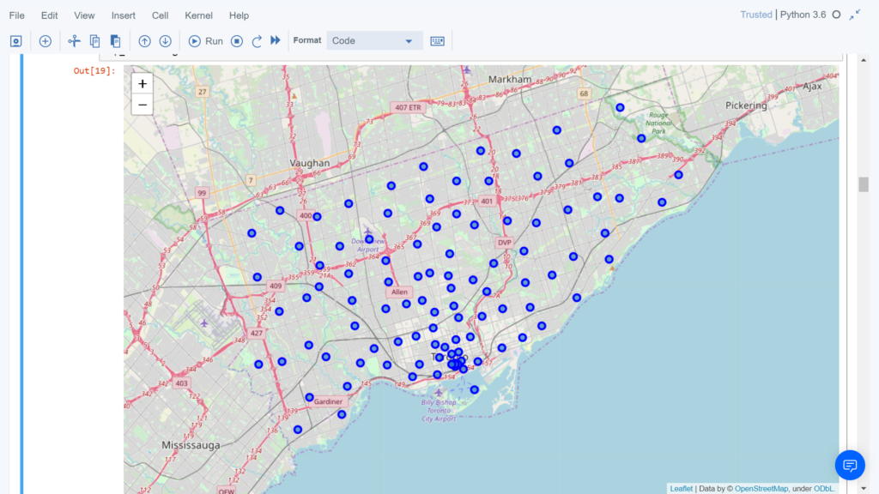
Data Section
The data retrieved from Foursquare contained information of venues within a specified distance of the longitude and latitude of the postcodes. The information obtained per venue as follows:
1. Neighborhood 2. Neighborhood Latitude 3. Neighborhood Longitude 4. Venue 5. Name of the venue e.g. the name of a store or restaurant 6. Venue Latitude 7. Venue Longitude 8. Venue Category
Map of Scarborought

Slide 5
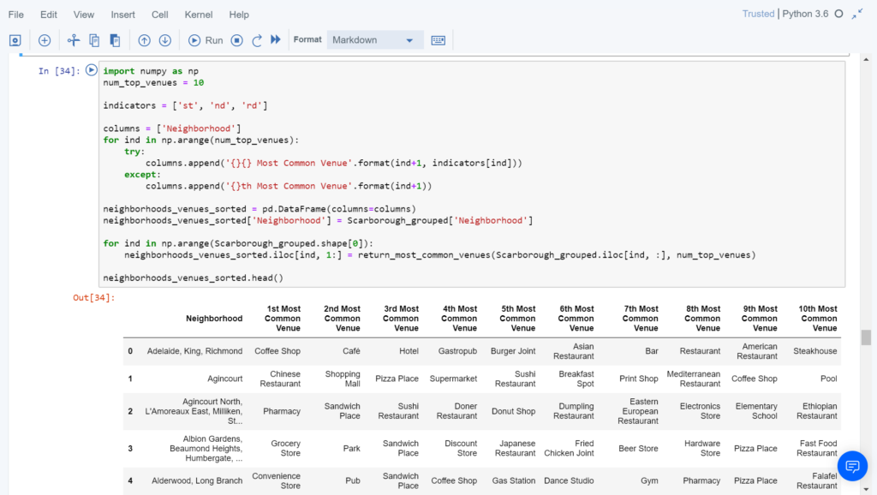
Methodology Section
To compare the similarities of two cities, we decided to explore neighborhoods, segment them, and group them into clusters to find similar neighborhoods in a big city like New York and Toronto. To be able to do that, we need to cluster data which is a form of unsupervised machine learning: k-means clustering algorithm.
Most Common Venues near Neighborhood

Slide 6
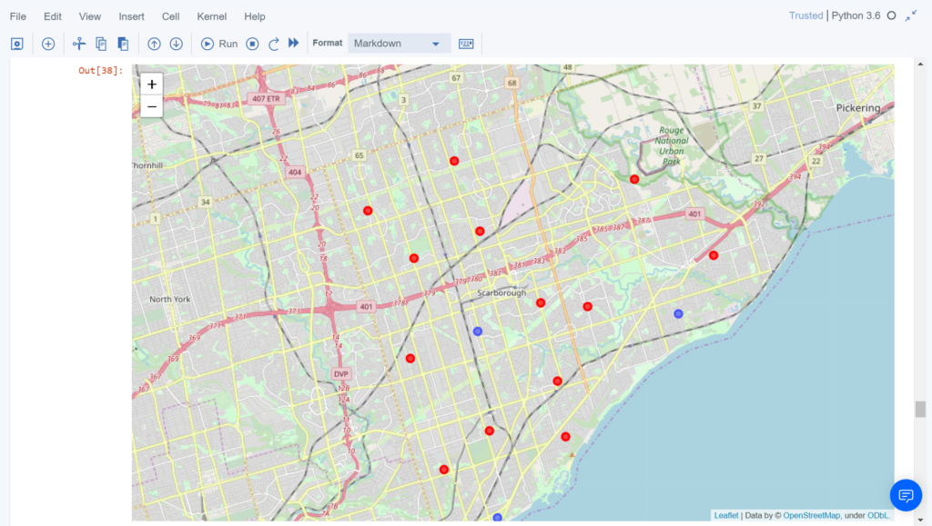
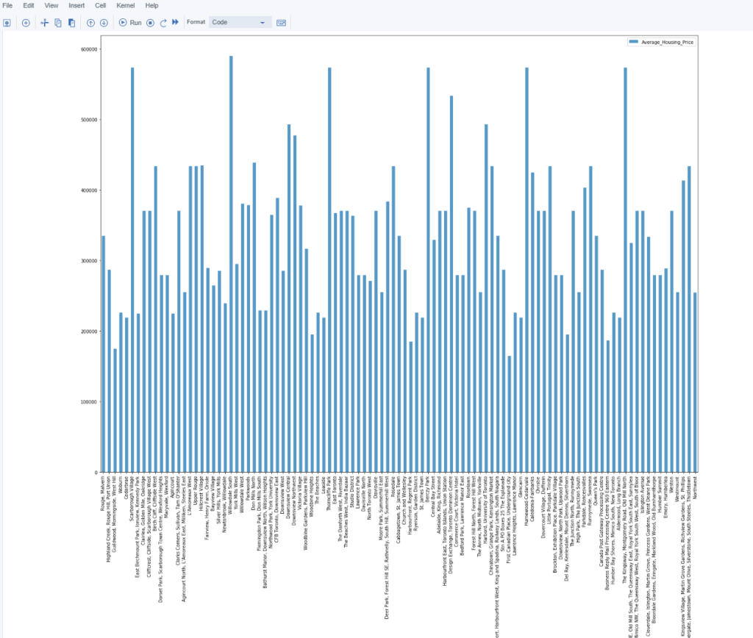
Results Section
Map of Clusters in Scarborough
Average Housing Price by Clusters in Scarborough

Slide 7
Discussion Section
The major purpose of this project, is to suggest a better neighborhood in a new city for the person who are shiffting there. Social presence in society in terms of like minded people. Connectivity to the airport, bus stand, city center, markets and other daily needs things nearby.
Sorted list of house in terms of housing prices in a ascending or descending order
Sorted list of schools in terms of location, fees, rating and reviews

Slide 8
Conclusion Section
In this Capstone project, using k-means cluster algorithm I separated the neighborhood into 10(Ten) different clusters and for 103 different lattitude and logitude from dataset, which have very-similar neighborhoods around them. Using the charts above results presented to a particular neighborhood based on average house prices and school rating have been made.
This project has shown me a practical application to resolve a real situation that has impacting personal and financial impact using Data Science tools. The mapping with Folium is a very powerful technique to consolidate information and make the analysis and decision better with confidence.

